Slide 1
What’s new in Java 8 (Functional programming for dysfunctional teams)
Nagesh Nayudu
Analytic Services
Predix ASE

Slide 2

The Hook

Slide 3
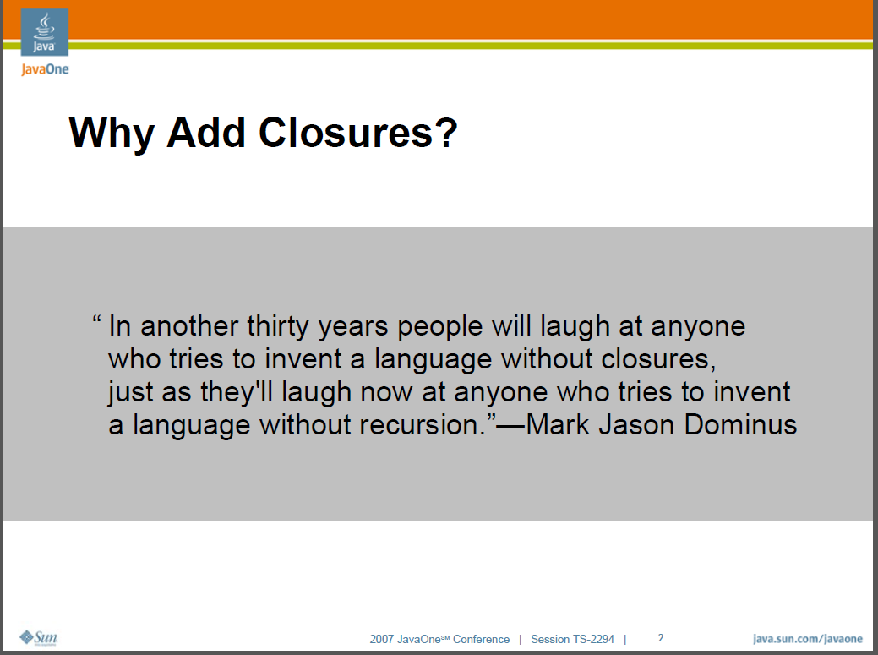

Slide 4

The Line

Slide 5
Java 8 – salient features
Support for functional programming paradigm
Lambda expressions
Functional interfaces
Default methods
Streams
Method references
Constructor references
Optional – The politically correct way of dealing with null
Date and Time API – how do you manage your time?
No more PermGen – What?!!! But, but…what about my classes? Where do they live?

Slide 6
Functional programming
Derived from Lambda Calculus, which influenced functional programming
Declarative (vs. imperative)
No side effects
Idempotent functions
Functions are first-class citizens
Supported by C#, Haskell (non-JVM languages)…
And Scala, Clojure, Groovy (JVM languages)…
And finally Java (with Java 8)

Slide 7

Lambda Expressions

Slide 8
Lambda Expressions
Because anonymous inner classes are a pain when you need Behavior Parameterization
Syntax
param -> expression
(params) -> expression
(params) -> statement
(params) -> {statements}
Examples, you ask?

Slide 9
Lambda…
Without Java 8
Runnable rAnonymous = new Runnable(){
@Override
public void run() {
System.out.println("Hello from anonymous inner runnable class!");
}
};
rAnonymous.run();
With Java 8
Runnable rLambda = () -> System.out.println("Hello from Runnable Lambda!");
rLambda.run();

Slide 10
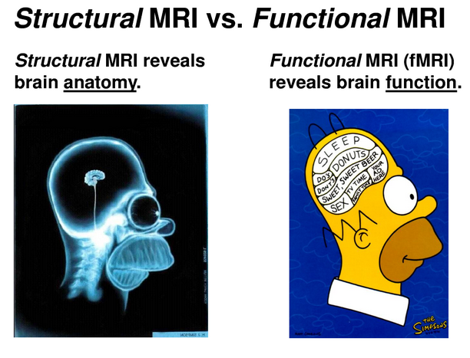

Slide 11
Functional Interfaces
What it is it?
An interface that describes one and only one abstract method
Why?
Lambda expressions can be treated as instances of functional interfaces based on target type.
What do you mean?
What are the ‘types’ of the following lambda expressions?
() -> System.out.println("Hello from runTheRunnable")
() -> {System.out.println("Hello from callTheCallable"); return new Integer(10);}

Slide 12
Examples of Functional Interfaces
Runnable
public void run();
Callable
public V call() throws Exception;
ActionListener
void actionPerformed(ActionEvent e)
Comparable
int compareTo(T o)

Slide 13
Functional Interfaces
Examples in Java 8
java.util.function.Predicate
boolean test(T t)
java.util.function.Supplier
T get()
java.util.function.Function<T, R>
R apply(T t)
@FunctionalInterface – annotation that helps the compiler verify that the interface has only one abstract method

Slide 14


Slide 15
Default Methods
What are they?
Methods with implementation in interfaces? WHAT?!!!!
Why?
Evolutionary Design. Let’s you add methods to interfaces without worrying about breaking backward compatibility.
A place to implement optional and convenience methods. No more ‘Collections’ class.
What about the dreaded diamond problem?

Slide 16


Slide 17
Streams API
Facilitates external iteration (as opposed to what?)
Lazy
Intermediate operations
Return another stream
Can and will be piped together
Ex: filter, map, limit, distinct, sorted
Terminal operations
Finish the processing
Ex: count, forEach, collect
Regular streams vs. parallel streams

Slide 18
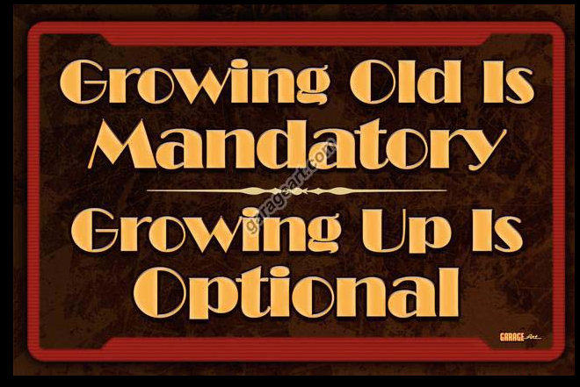
Optional

Slide 19
Optional – cure for NPEs?
java.util.Optional<T>
From JDK docs
“A container object which may or may not contain a non-null value. If a value is present, isPresent() will return true and get() will return the value.”
Udy, did you write it?
Best used for APIs which might return null values
public Optional<Entity> findEntity(Long id)
Not a replacement for all nulls

Slide 20
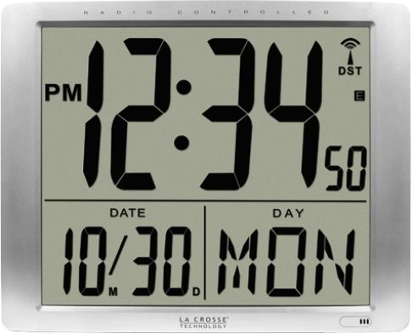
Date and Time

Slide 21
Date and Time API
New classes introduced in java.time package
LocalDate
LocalTime
LocalDateTime
TemporalAdjusters

Slide 22

Memory management

Slide 23
Memory management changes
Before Java 8
Young generation (aka Udyallen generation)
Old generation (aka Nagesh generation)
PermGen
After Java 8
Young generation (aka not-so-young generation)
Old generation (aka older generation)
Metaspace – allocated in native memory

